Slide 1
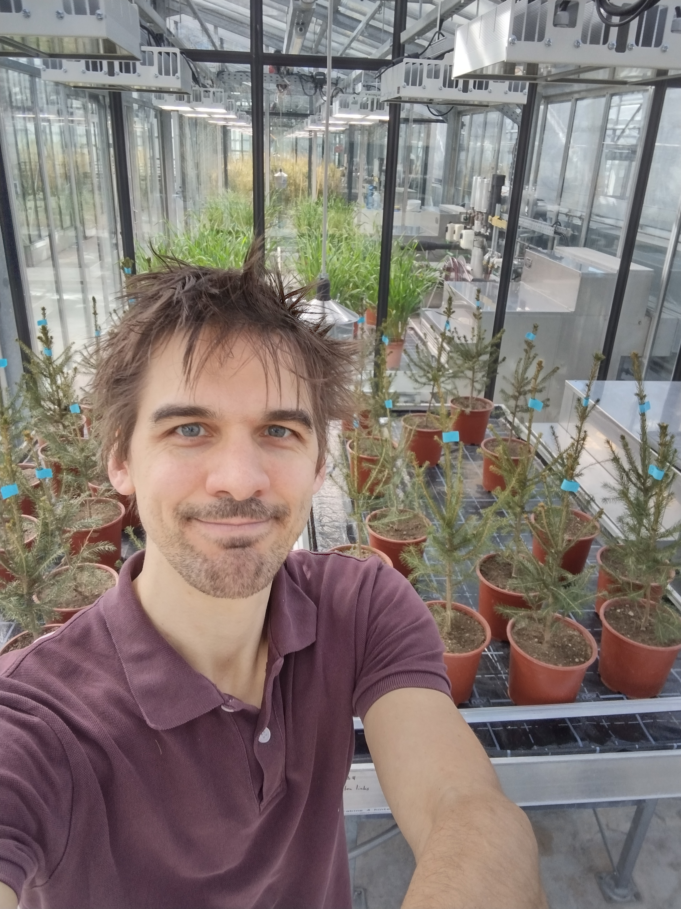
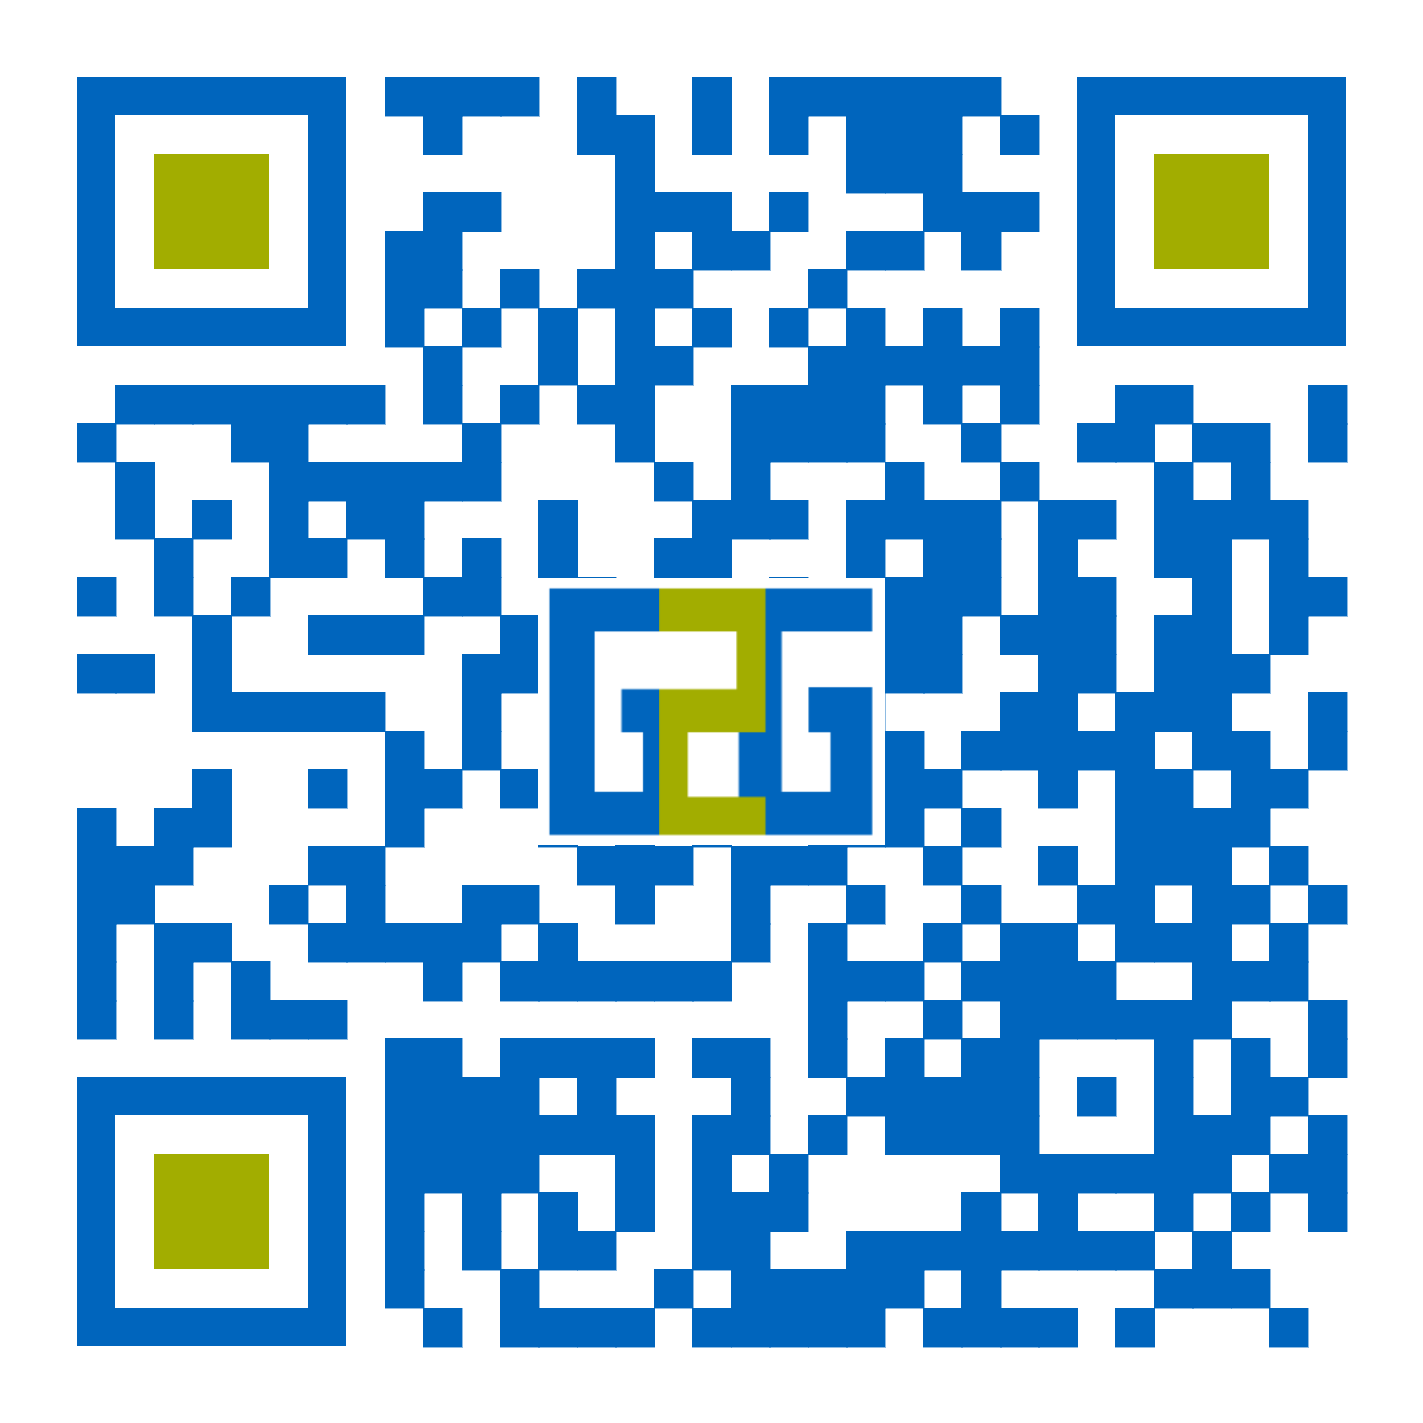
Professorship of Wood Science and Functionalization
Dr. Sebastian J. Antreich
Prof. Dr. Michaela Eder
TUM School of Life Sciences
Department of Life Science Engineering
Professorship of Wood Science and Functionalization
Hans-Carl-von-Carlowitz-Platz 2, 85354, Freising

